Slide 1

Job Posting
VP masters

Slide 2

Our Team
Plamen Kostov - Back-end & Scrum Master
Valentin Petrov – Front-end & Documentary

Slide 3


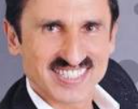
About our project
Ideas

Slide 4

Why exactly a job posing site

Slide 5






Used Technology

Slide 6


Future Ideas

Slide 7
Thank you for your attention!
Plamen Kostov – 10 B
Valentin Petrov – 10 G

